Slide 1


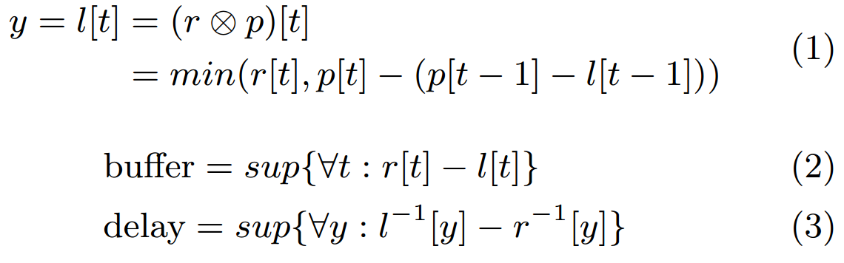
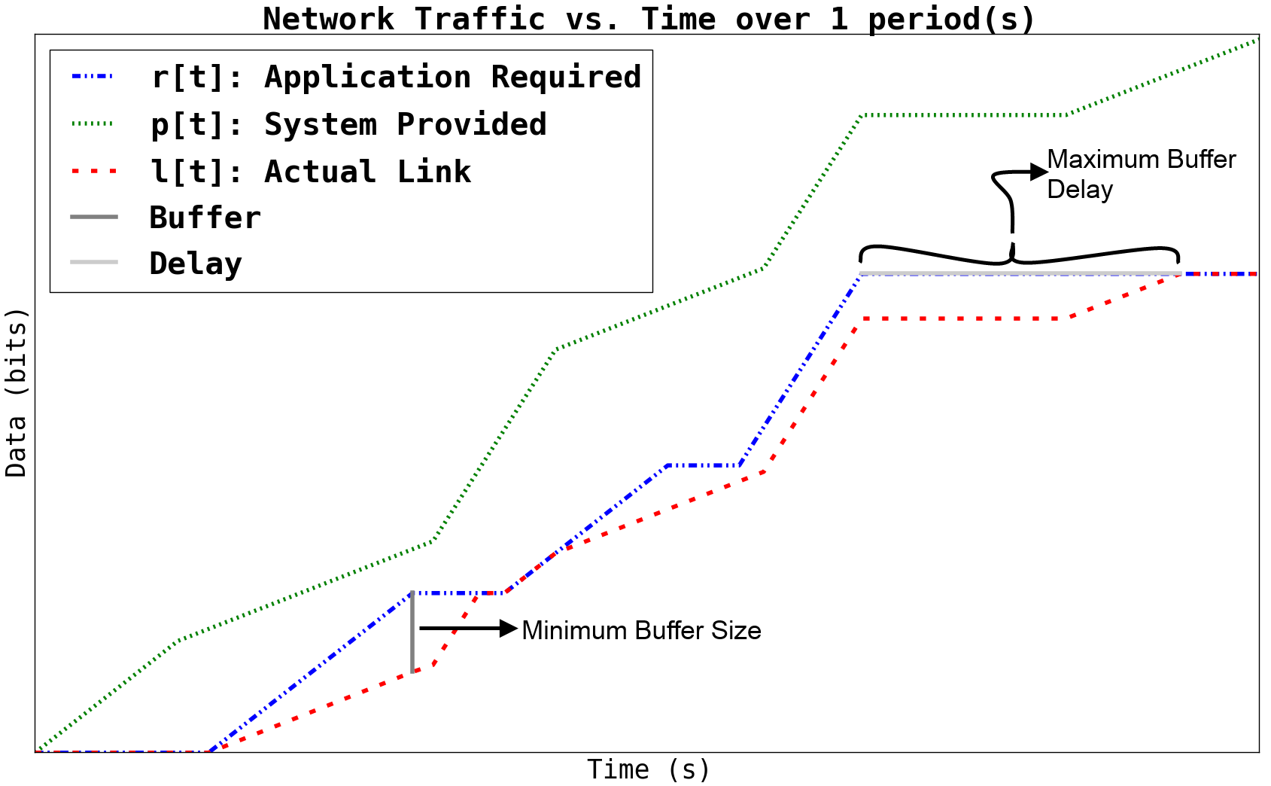
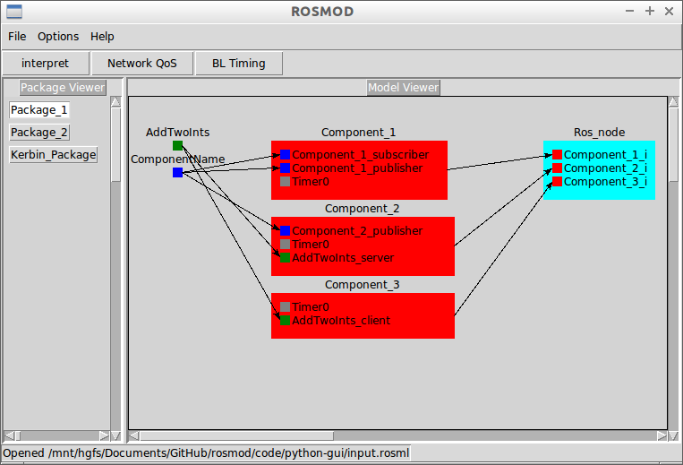
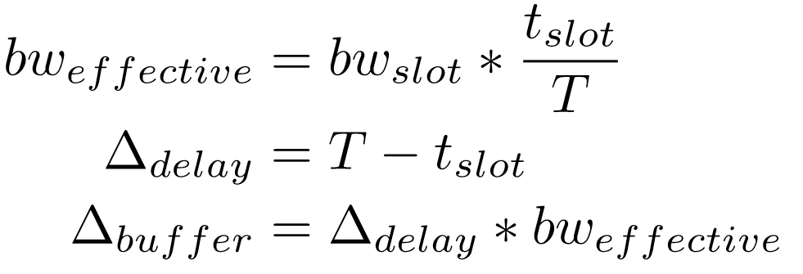
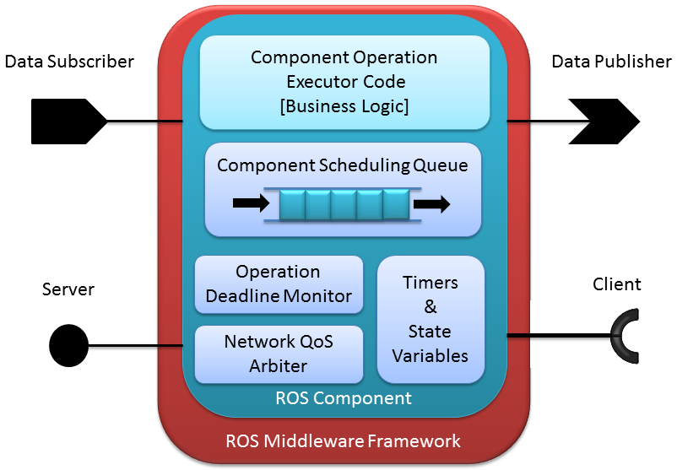
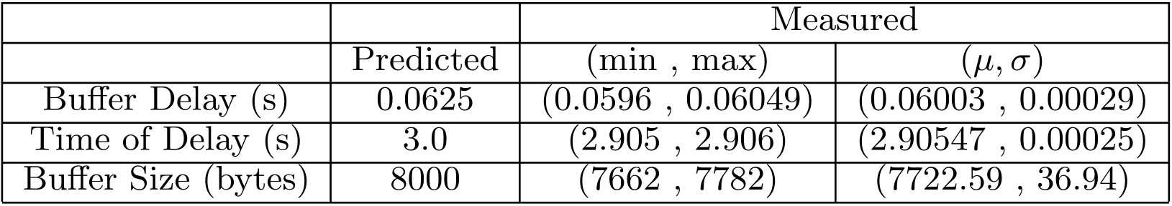
Network Analysis Paradigm for Detecting and Mitigating Attacks from Malicious Actors
William Emfinger, Gabor Karsai
Institute for Software-Integrated Systems, Vanderbilt University, 1025 16th Avenue South, Nashville, TN 37212, USA, +1(615)343-7472, {emfinger, gabor}@isis.vanderbilt.edu
System Description
COMPONENTIZED DISTRIBUTED APPLICATIONS
OVERVIEW
DETECTION AND MITIGATION
DDOS PREVENTION
Model application and system network traffic explicitly as data produced as a function of time
Use (min,+) calculus convolution to determine buffer size and delay incurred by the application
Measure the application data production at run-time
Enforce the application’s profile on all it’s communications flows
Deviations (e.g. DDoS attack) from components’ profiles detected as anomalies and mitigated by blocking entry to network
Application profiles provide information about baseline network performance and resource requirements
Application traffic which deviates from the supplied profiles is detected as an anomaly
All application network traffic must go through the communications middleware, which measures the traffic and compares it against the application’s supplied profile
Any traffic which is deemed an anomaly can be blocked from entering the kernel and the network, mitigating the anomaly
Actor
Actor
Malicious Node
Actor
Comp
Traffic allowed onto network only if it conforms to the component’s profile
Comp
Middleware
Comp
Network
Device
Comp
Comp
Comp
Comp
Middleware
Malicious Actor
Network /
Network Switch
Server
Middleware
Comp
Middleware
Network
Device
Operating System
Comp
Middleware
Using a programmable switch, we stop malicious nodes (internal or external) from flooding the server
THEORY
Network Device
Device
Device
Using the MW layer, we stop malicious actors or malicious components from flooding the server
Modeling System Network Provisions and Application Requirements
MIDDLEWARE INTEGRATION
All traffic generated by actors and their components deployed on our system must conform to the specified profile verified to compose a stable system
The measurement and enforcement built into the middleware layer ensures that no malicious component’s flood of traffic can DoS attack a server
The same enforcement running on a programmable switch / SDN ensures no compromised or external nodes can DDoS attack a server
Model the application data production profiles, the system data service profiles, and use (min,+) calculus convolution to produce the actual data sent on the link.
Required buffer size and delay incurred can be predicted
DREMS:
Network analysis algorithms and tools integrated into a modeling tool-suite allow for describing applications/systems and performing design-time network analysis and admittance
Measurement and enforcement code auto-generated into middleware code for every port of every component
Measures the traffic going out of the port onto the network
Enforces that the component’s port traffic does not exceed its supplied network profile
Node Communications Resource Manager on every node ensures that at all times, the traffic flowing out of the node onto the network conforms to the provided system profile
Robot Operating System:
Robot Operating System (ROS) is a lightweight middleware providing publish/subscribe interaction, point-to-point interaction, and timers
ROSMOD is a component model add-on for ROS supporting application composition, design-time analysis, and run-time enforcement : https://github.com/finger563/rosmod
Textual specification language for ROSMOD: ROSML allows the specification and generation of:
ROS Services (clients/servers), ROS Messages (pub/sub), ROS Timers, and ROS Nodes (processes)
ROSMOD Component Definitions and Instances
ROSMOD Graphical Editor allows developers to view/edit ROSML models and generate executable component application code
SUMMARY
Modeling and Analysis Paradigm for Communications Networks
Model application and system network requirements
Analyze models to determine buffer size and delay
Theory Verified by Experimental Results
Traffic generation which conforms to the application profiles, traffic shaping which enforces system profiles, and measurement code to determine buffer size and delay
Analysis, Detection, & Mitigation Implemented
Ensures that a malicious or malfunctioning application cannot disrupt communications
ROS Extension : ROSMOD
A component model for ROS and implementation with built-in enforcement and arbitration
Deviations from this profile are
Classified as Anomalies
Analysis of Network Medium Channel Access Protocol: TDMA
By integrating TDMA into the analysis, we derive formulas for how much the results with TDMA differ from those without; meaning system models do not explicitly need TDMA modeled
COMPONENTS AND COMPONENT OPERATIONS
A component is a unit (containing potentially many objects). The component is parameterized, has state, it consumes resources, publishes and subscribes to topics, provides interfaces to and requires interfaces from other components.
Publish/Subscribe: Event-driven, asynchronous communication (publisher does not wait)
Client/Server: Synchronous communication using call/response semantics.
Triggering can be time-driven or event-driven; Timers can be periodic or one-shot.
Verification of Analysis Results
ONGOING WORK
Applications generate network traffic according to each supplied network profile
System uses traffic shaping to enforce the system network profiles
Enforcement and Arbitration built into ROSMOD components for anomaly detection in ROSMOD
Generation of network profiles from component business logic models
Classification of different types of anomalies for specific mitigation at run-time
Extension of theory to routed/dynamic networks and adaptive systems
Single threading: Every component has a single-thread – only one operation can be active in a component at any time.
When an operation becomes eligible (arrival of event/call, timer, etc.), it is placed into the scheduling queue of the component.
A scheduler picks the next operation from the queue using a selectable scheduling policy (FIFO, priority FIFO or EDF) and runs it in the executor thread
Each Operation’s stated deadline is monitored and enforced
This work was supported by the DARPA System F6 Program and AFRL SURE. Any opinions, findings, and conclusions or recommendations expressed in this material are those of the author(s) and do not reflect the views of DARPA or AFRL.

